Slide 1
Mean (Expected Value) & Standard deviation

Slide 2
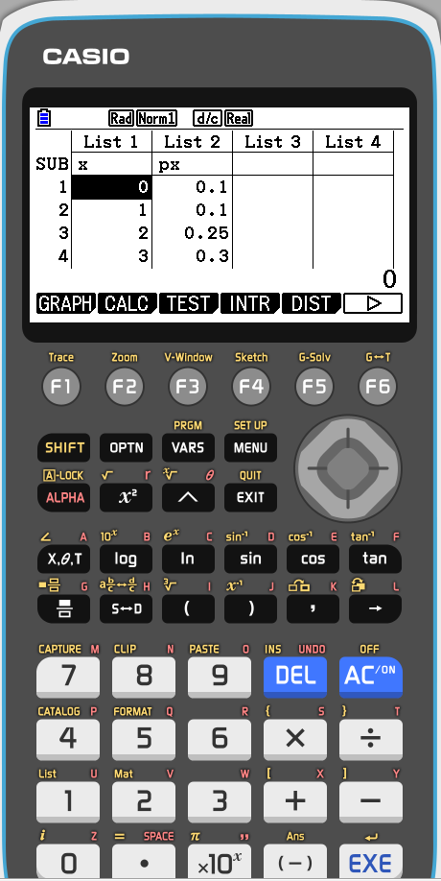
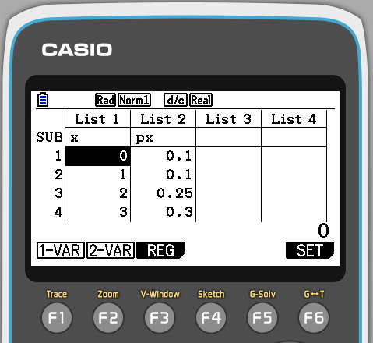
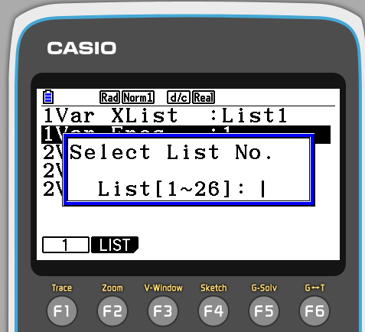
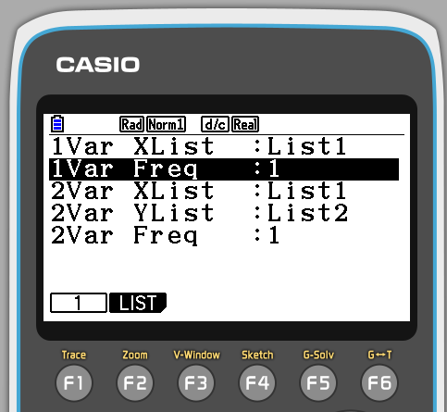
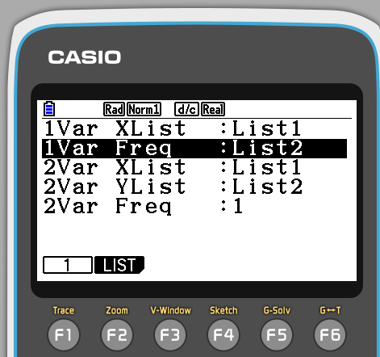

Slide 3
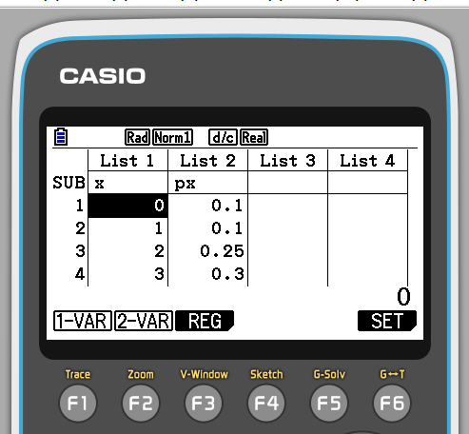
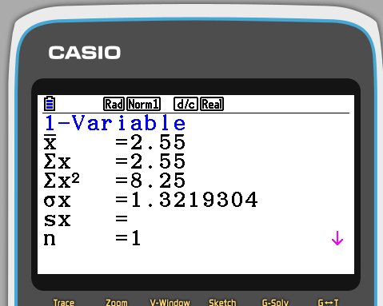
Mean (Expected Value) ☺
Standard deviation ☺

Slide 4
Binomial cumulative distribution
X | -1 | 0 | 1 | 2
P(X) | 0.1 | 0.3 | 0.2 | 0.4
Binomial Probability Distribution
X | -1 | 0 | 1 | 2
P(X) | 0.1 | 0.4 | 0.6 | 1
X | -1 | 0 | 1 | 2
P(X) | 0.1 | 0.1+0.3 | 0.1+0.3+0.2 | 0.1+0.3+0.2+0.4
Binomial Cumulative Distribution

Slide 5
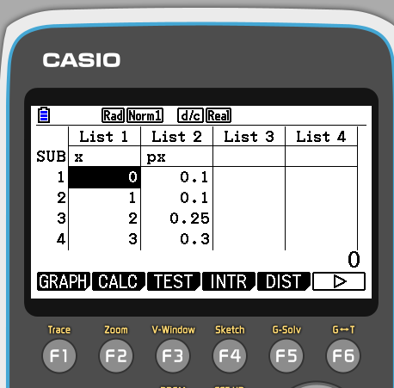
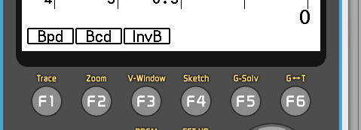
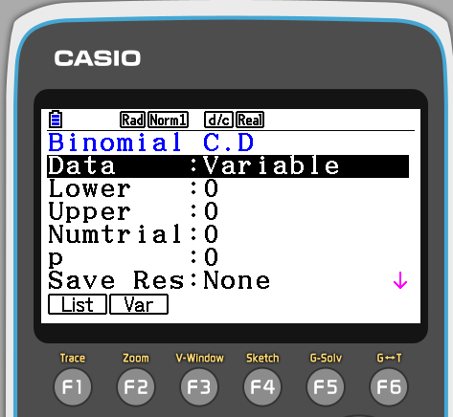
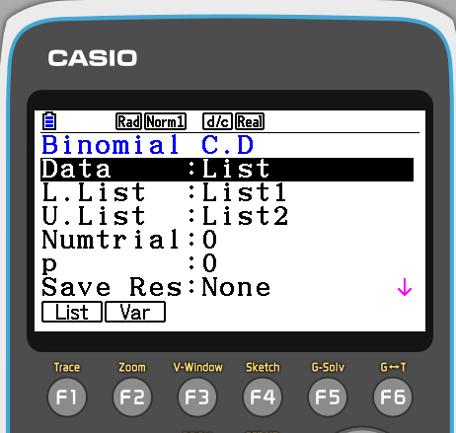
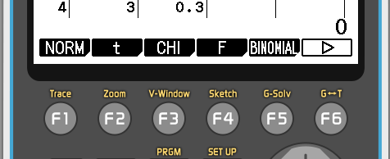
Binomial cumulative distribution

Slide 6
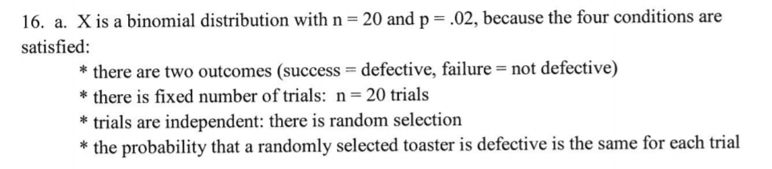
22.a.
We can expect to have to repair our mp3 player once over its lifetime, but that vary on average by 1 repair typically.
b.
We expect to have to perform 3 repairs, total, on our devices over their lifetimes, but that amount can vary on average by about 1.562 repairs typically.

